Slide 1
Towards Automated Merging of Code Clones in Object-Oriented Programming Languages
Simon Baars
8 May 2019
Notes:
Hi. I’m doing this thesis. My host company is SIG. They assess companies on basis of their maintainability model.
Automation has always been a personal interest of me. I chose this subject because with refactoring we change the design of the code according to certain guidelines. I think that a large part of refactoring can be formalized and applied automatically. However, if you do something like this automatically, you want to be correct.
Before being able to actually refactor the clones, we must first detect them. Because of that, I first looked into clone detection tools.

Slide 2
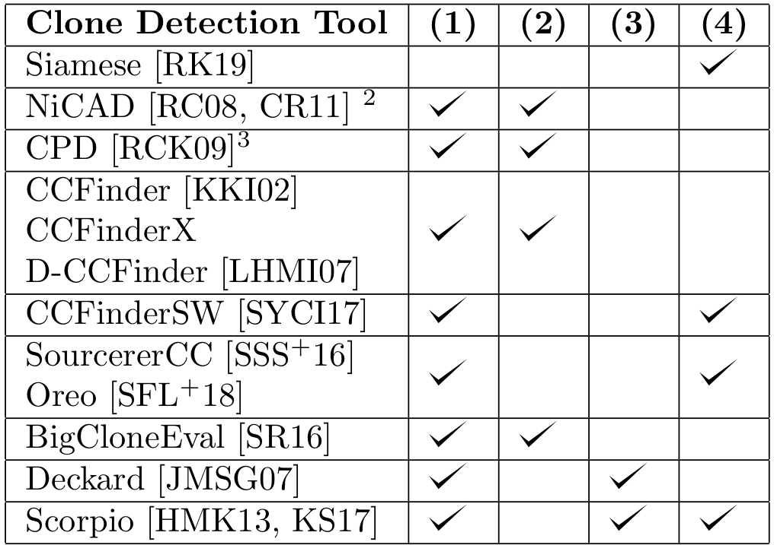
Clone Detection
Should find clones in any context.
Should detect clone classes in a number of example projects.
Considers dependency graphs to be sure that this clone can be merged.
Makes it possible to configure the way in which clones are detected in a relatively straightforward way.
Notes:
Most clone detection tools focus on efficiency and supporting a lot of types of clones and a .
The main focus for clone detection tools:
Efficiency/large scale
Supporting many types of clones
Supporting many programming languages

Slide 3
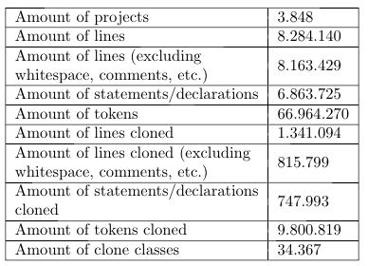
Java Corpus
Corpus with 14.436 Java projects
Assembled on basis of machine learning
No duplicate projects
Higher quality projects
No generated files
Notes:
We then filtered the corpus further to make sure we are not including any test classes or generated classes. Many Java/Maven projects use a structure where they separate the application and it's tests in the different folders (``/src/main/java'' and ``/src/test/java'' respectively). Because of this, we chose to only use projects from the corpus which use this structure (and had at least a ``/src/main/java'' folder). To limit the execution time of the script, we also decided to limit the maximum amount of source files in a single project to 1.000 (projects with more source files were not considered, which filtered only 5 extra projects out of the corpus). Of the 14.436 projects in the corpus over 3.848 remained, which is plenty for our purposes.

Slide 4
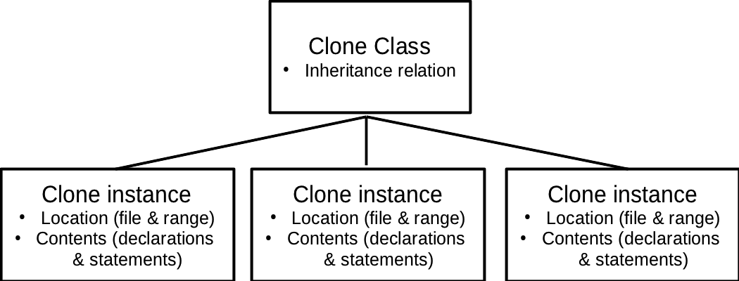
Code Clone Context
How are cloned instances related, where is my clone located and what does my clone contain?
The context of a clone has three aspects that are of importance to how the clone can be merged:
Relation between clone instances
Location of the clone
Contents of a clone instance
Collected statistics over the corpus
Notes:
To be able to refactor code clones, it is very important to consider the context of the clone. We define the following aspects of the clone as its context:
\item The relation of clone instances among each other (for example: two clone instances in a clone class are part of the same object).
\item Where a clone instance occurs in the code (for instance: a method-level clone is a clone instance that is (a part of) a single method).
\item The contents of a clone instance (for instance: the clone instance consists of a one method declaration, a foreach statement and two variable declarations).
Everything in the context of a clone has a big impact on how it has to be refactored. For this study we performed measurements on the context of clones in a large corpus of open source projects.

Slide 5
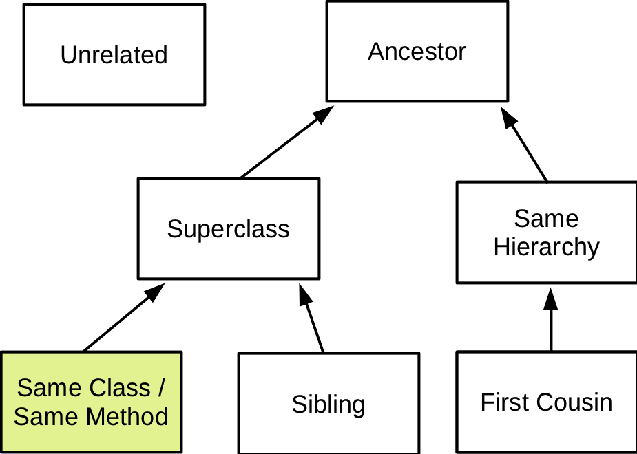
Clone Relations
Relation through inheritance between clone instances
Notes:
We took the categories from an existing study.
We don’t take into account external classes, as they aren’t interesting for refactoring.
We have an extra category that is not modelled here: same external superclass.

Slide 6
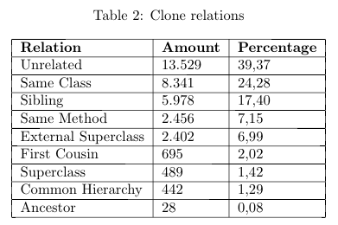
Relation between clone instances
Notes:
A paper by Fontana et al \cite{fontana2015duplicated} performs measurements on 50 open source projects on the relation of clone instances to each other. To do this, they first define several categories for the relation between clone instances in object-oriented languages. These categories are as follows:
\item \textbf{Same method}: All instances of the clone class are in the same method.
\item \textbf{Same class}: All instances of the clone class are in the same class.
\item \textbf{Superclass}: All instances of the clone class are children and parents of each other.
\item \textbf{Ancestor class}: All instances of the clone class are superclasses except for the direct superclass.
\item \textbf{Sibling class}: All instances of the clone class have the same parent class.
\item \textbf{First cousin class}: All instances of the clone class have the same grandparent class.
\item \textbf{Common hierarchy class}: All instances of the clone class belong to the same hierarchy, but do not belong to any of the other categories.
\item \textbf{Same external superclass}: All instances of the clone class have the same superclass, but this superclass is not included in the project but part of a library.
\item \textbf{Unrelated class}: There is at least one instance in the clone class that is not in the same hierarchy.
\end{enumerate}
Please note that no of these categories allow external classes (except for ``same external superclass''). So if two clone instances are related through external classes but do not share a common external superclass, it will be flagged as ``unrelated''. The main reason for this is that it is (often) not possible to refactor to external classes.
Comparing it to the results of Fontana et al \cite{fontana2015duplicated}, we find way more unrelated clones. This might be due to the fact that we consider clone classes rather than clone pairs, and mark the clone class ``Unrelated'' even if just one of the clone instances is outside a hierarchy. It could also be that the corpus which we use, as it has generally smaller projects, use more classes from outside the project (which are marked UNRELATED if they do not have a common external superclass). On the second place, we have the ``Same Class'' clones. On the third place come the ``Sibling'' clones.
The ranking of the previous list of categories also matters, as it shows the different levels in which clones were assessed. For instance, if two clone instances of a clone class belong to the ``same method'' category but the third belongs to the ``same class'', we will always chose the item lowest on the list.
\subsubsection{Our measurements}
We have recreated table 3 of Fontana et al \cite{fontana2015duplicated}, but with the following differences in our setup:
\begin{itemize}
\item We consider clone classes rather than clone pairs.
\item We use different thresholds regarding when a clone should be considered.
\item We seek by statement/declaration rather than SLOC.
\item We test a broader range of projects (they use a set of 50 relatively large projects, we use a large corpus that was assembled by a machine learning algorithm testing java projects on GitHub for quality, which contains projects of all sizes and with differing code quality).

Slide 7
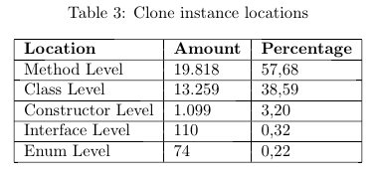
Location of clones
Notes:
A study by Lozano found that 98% of clones were produced at method level. I seriously questioned his research, so I set out to look into this myself. Method level clones are definitely the most, but there’s also a lot of class level.
After mapping the relations between individual clones, we looked at the location of individual clone instances. A paper by Lozano et al \cite{lozano2007evaluating} discusses the harmfulness of cloning. In this paper the author argues that 98\% are produced at method-level. However, this claim is based on a small dataset and based on human copy-paste behaviour rather than static code analysis. We validated this claim over the corpus we use. For this, we chose the following categories:
\begin{enumerate}
\item \textbf{Method/Constructor Level:} A clone instance that does not exceed the boundaries of a single method or constructor (optionally including the declaration of the method or constructor itself).
\item \textbf{Class Level:} A clone instance in a class, that exceeds the boundaries of a single method or contains something else in the class (like field declarations, other methods, etc.).
\item \textbf{Interface Level:} A clone that is (a part of) an interface.
\item \textbf{Enumeration Level:} A clone that is (a part of) an enumeration.
\end{enumerate}
The results for the clone instance locations are shown in table \ref{table:locations}.
From these results we can see, somewhat surprisingly, that the claim of 98\% of clones being produced at method-level is nowhere near correct. In fact, around 58\% of the clones are produced at method-level. About 39\% of clones either span several methods/constructors or contain something like a field declaration. Another 3\% of the clones is found in contructors. The amount of clones found in interfaces and enumerations is very low.

Slide 8
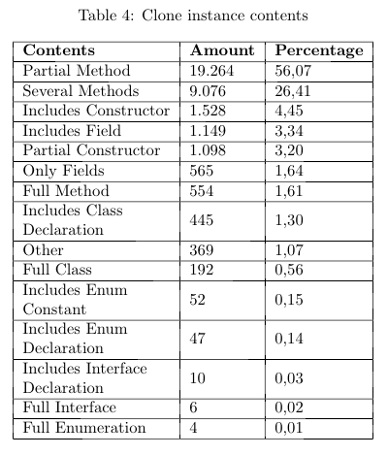
Contents of clones
What do clones span?
Notes:
Finally, we looked at the contents of individual clone instances: what kind of declarations and statements do they span. We selected the following categories to be relevant for refactoring:
\begin{enumerate}
\item \textbf{Full Method/Class/Interface/Enumeration:} A clone that spans a full class, method, constructor, interface or enumeration, including its declaration.
\item \textbf{Partial Method/Constructor:} A clone that spans a method partially, optionally including its declaration.
\item \textbf{Several Methods:} A clone that spans over two or more methods, either fully or partially, but does not span anything but methods (so not fields or anything in between).
\item \textbf{Only Fields:} A clone that spans only global variables.
\item \textbf{Includes Fields/Constructor:} A clone that spans a combination of fields and other things, like methods.
\item \textbf{Method/Class/Interface/Enumeration Declaration:} A clone that contains the declaration (usually the first line) of a class, method, interface or enumeration.
\item \textbf{Other:} Anything that does not match with above stated categories.
\end{enumerate}
Unsurprisingly, most clones span a part of a method. Just 1.6\% of the methods are cloned fully. More than a quarter of the clones spans over several methods, which is surprising. Simply extracting methods won't work in a case where a clone spans over several methods. About 4.5\% of clones include a constructor. About 3.3\% of clones include a global variable defined in a class.

Slide 9
Clone types
How can we automatically refactor different types of clones?
Type 1: Identical code fragments except for variations in whitespace (may be also variations in layout) and comments.
Type 2: Structurally/syntactically identical fragments except for variations in identifiers, literals, types, layout and comments.
Type 3: Copied fragments with further modifications. Statements can be changed, added or removed in addition to variations in identifiers, literals, types, layout and comments.
Type 4: Two or more code fragments that perform the same computation but implemented through different syntactic variants.
Notes:
There are a lot of studies that implement clone detection tools to detect these types of clones. For most tools, the main point of focus is effe
A higher type of clone means that it's harder to detect. It also makes the clone harder to refactor, as more transformations would be required. Higher clone types also become more disputable whether they actually indicate a harmful antipattern (not every clone is harmful). Type 1 clones are most often, if not always with the right thresholds, harmful. Type 2 and type 3 clones are more disputable whether they are harmful and whether they can be merged in a way that improves the design of the code.

Slide 10
Seems like a type 1 clone right?
Notes:
When you advise a refactoring, someone is going to look at it. This means that this person will be able to filter eventual false positives. With automatic refactor, you do not have/want this. So you need to be sure a clone is actually a clone.

Slide 11
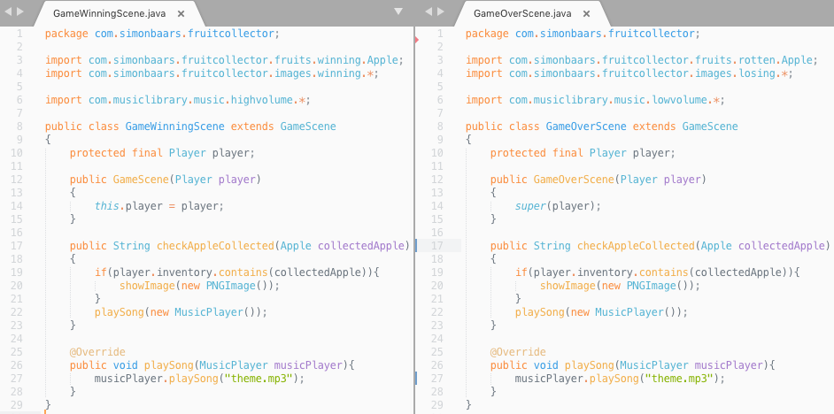
How can we be sure if this is actually a clone?
Notes:
MusicPlayer can:
Be a highvolume MusicPlayer from the musiclibrary highvolume package
Can be in the images winning package
Can be in the current package
Can be in the default package
To be sure we need to:
Consider FQI for types
Consider FQI for the types of variables
Consider FQI for methods

Slide 12
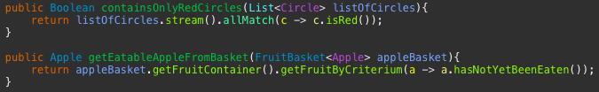
Type 2 clones
How can we automatically refactor different types of clones?
“Structurally/syntactically identical fragments except for variations in identifiers, literals, types, layout and comments.”
Type 2 clones don’t always make a whole lot of sense:
Notes:
Type 2 clones, by definition, allow any change in identifiers, literals, types, layout and comments. For refactoring purposes, this doesn't always make a lot of sense. If we allow any change in identifiers, literals and types, we cannot distinguish between different variables, different types and different method calls anymore. This could render two methods that have an entirely different functionality as clones. Merging such clones, if possible at all, might only proof to be harmful.

Slide 13
Type 2 clones
How can we automatically refactor different types of clones?
“Structurally/syntactically identical fragments except for variations in identifiers, literals, types, layout and comments.”
For refactoring purposes, we change type 2 clones as follows:
Considering types (let’s not turn apples into oranges)
Not only direct references to types but also the types under which variables were declared!
Having a distinction between different variables
callMethod(var1, var1); != callMethod(var1, var2);
Defining a threshold for variability in literals
Notes:
\item \textbf{Considering types:} The definition of type 2 clones defines that types should not be considered. We disagree, because types can make a significant change to the meaning of a code segment and thus whether this segment should be considered a clone. For instance, we should not say that an Apple type object is the same as an object of Orange type (don't compare apples with oranges).
\item \textbf{Having a distinction between different variables:} By the definition of type 2 clones any identifiers would not be taken into account. We agree that a difference in identifiers may still result in a harmful clone, but we should still consider the distinction between different variables. For instance, if we call a method like this: \textit{``myMethod(var1, var2)''}, or call this method like this: \textit{``myMethod(var1, var1)''}. Even if the variables have the same type, the distinction between the variables is important to ensure the functionality is the same after merging.
\item \textbf{Defining a threshold for variability in literals:} By the definition of type 2 clones any literals would not be taken into account. We agree, as when merging the clone (for instance by extracting a method), we can simply turn the literal into a method parameter. However, we would argue that thresholds matter here. How many literals may differ for the segment still to be considered a clone with another segment? We need to define a threshold to be sure that, by merging, we are not replacing a code fragment by a worse maintainable design.

Slide 14
Next steps
Look more into individual clones to determine more fine-grained information about them
Running all scripts with my type-2 and type-3 definitions
Figuring out good thresholds by plotting distribution
Filtering out “non-harmful patterns”
Defining actual refactorings
… writing a great thesis ☺

Slide 15
+31 6 22 67 92 65 s.baars@sig.eu
Simon Baars
Xander Schrijen
Ana Oprescu
+31 6 12 04 48 59
x.schrijen@sig.eu
?
A.M.Oprescu@uva.nl

Slide 16
Type 3 clones
Notes:
Type 3 clones are even more permissive than type 2 clones, allowing added and removed statements. Thresholds matter a lot here to make sure that not the whole project is detected to be cloned. The main question for this study regarding type 3 clones is: ``how can we merge type 3 clones while improving the design?''.
Clone instances in type 3 clones are almost always different in functionality. As we have to ensure equal functionality after merging the clone, we have to wrap the difference in statements between the clone instances in conditional blocks (either if-statements or switch-statements). We can then pass a variable as to which path should be taken through the code (either a boolean or an enumeration). Such a refactoring would make added statements that are contiguous less harmful for the design then added statements than added statements that are separated by statements that both clone instances have in common.
We also want to argue that statements that are not common between two clone instances, should not count towards the size of the clone (and thus towards the threshold which determines whether the clone will be taken into account). Also, clones should not start and not end with an added statement (as that would be nonsense: such a thing could be done for any clone).

Slide 17
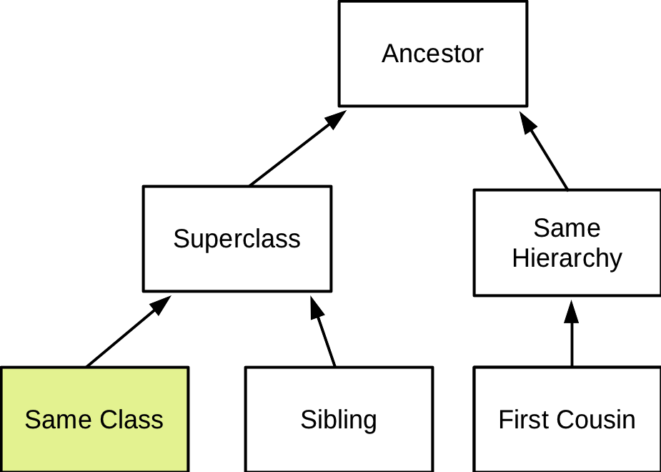
Clone relation

Slide 19
Preparing a corpus
GitHub Java Corpus: Corpus of 14.436 Java projects
Filtering all Maven projects
Gathering all dependencies
Filter too large/broken projects
Result: 1360 projects + all dependencies

Slide 20
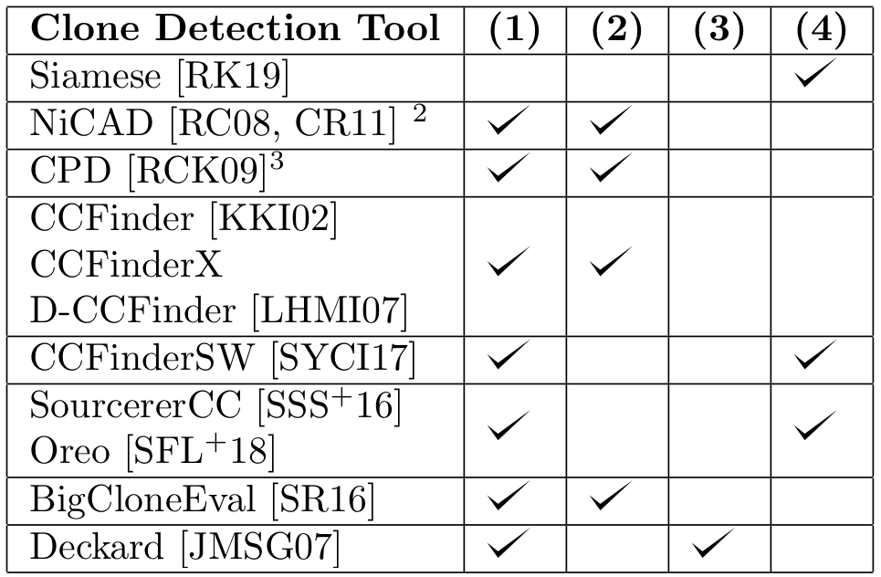
Clone Detection
Should find clones in any context.
Should detect clone classes in a number of example projects.
Considers dependency graphs to be sure that this clone can be merged.
Makes it possible to configure the way in which clones are detected in a relatively straightforward way.

Slide 21
Thresholds for Clone Detection
What to do with them?
We define three thresholds to detect clones:
Number of statements/declarations: The amount of statements/declarations that should be equal/similar for it to be considered a clone.
Number of tokens: The amount of tokens (excluding whitespace, end-of-line terminators and comments) that should be equal/similar for it to be considered a clone.
Number of lines: The minimum amount of lines (excluding lines that do not contain any tokens, for tokens same exclusions apply) that should be equal/similar for it to be considered a clone.
Number of statements/declarations: 6
Number of tokens: 10
Number of lines: 6
Number of statements/declarations: ?
Number of tokens: ?
Number of lines: ?
Number of statements/declarations: 1
Number of tokens: 50
Number of lines: 1
Notes:
Of course, if we put any of these thresholds to zero it won't be taken into account anymore, so not all thresholds have to be used at all times. We consider ``number of lines'' to be the least important, as it highly depends on the programmer of the codebase (and we do not want this kind of dependence!). On basis of manual assessment, we have determined that setting the ``number of statements/declarations'' to 6 ensures that most non-harmful clones are filtered out. On the downside, this also filters out some harmful antipatterns, for instance if a cloned line has many tokens we might want to consider a clone if it spans less than 6 statements (as cloned line with many tokens is more harmful than one with few).

Slide 22
Java Corpus
Corpus with 14.436 Java projects
Assembled on basis of machine learning
No duplicate projects
Higher quality projects
No generated files
Notes:
We then filtered the corpus further to make sure we are not including any test classes or generated classes. Many Java/Maven projects use a structure where they separate the application and it's tests in the different folders (``/src/main/java'' and ``/src/test/java'' respectively). Because of this, we chose to only use projects from the corpus which use this structure (and had at least a ``/src/main/java'' folder). To limit the execution time of the script, we also decided to limit the maximum amount of source files in a single project to 1.000 (projects with more source files were not considered, which filtered only 5 extra projects out of the corpus). Of the 14.436 projects in the corpus over 3.848 remained, which is plenty for our purposes.

Slide 23
Code Clone Context
How are cloned instances related, where is my clone located and what does my clone contain?
The context of a clone has three aspects that are of importance to how the clone can be merged:
Relation between clone instances
Location of the clone
Contents of a clone instance
Collected statistics over the corpus
Notes:
To be able to refactor code clones, it is very important to consider the context of the clone. We define the following aspects of the clone as its context:
\item The relation of clone instances among each other (for example: two clone instances in a clone class are part of the same object).
\item Where a clone instance occurs in the code (for instance: a method-level clone is a clone instance that is (a part of) a single method).
\item The contents of a clone instance (for instance: the clone instance consists of a one method declaration, a foreach statement and two variable declarations).
Everything in the context of a clone has a big impact on how it has to be refactored. For this study we performed measurements on the context of clones in a large corpus of open source projects.

Slide 24
Relation between clone instances
Notes:
A paper by Fontana et al \cite{fontana2015duplicated} performs measurements on 50 open source projects on the relation of clone instances to each other. To do this, they first define several categories for the relation between clone instances in object-oriented languages. These categories are as follows:
\item \textbf{Same method}: All instances of the clone class are in the same method.
\item \textbf{Same class}: All instances of the clone class are in the same class.
\item \textbf{Superclass}: All instances of the clone class are children and parents of each other.
\item \textbf{Ancestor class}: All instances of the clone class are superclasses except for the direct superclass.
\item \textbf{Sibling class}: All instances of the clone class have the same parent class.
\item \textbf{First cousin class}: All instances of the clone class have the same grandparent class.
\item \textbf{Common hierarchy class}: All instances of the clone class belong to the same hierarchy, but do not belong to any of the other categories.
\item \textbf{Same external superclass}: All instances of the clone class have the same superclass, but this superclass is not included in the project but part of a library.
\item \textbf{Unrelated class}: There is at least one instance in the clone class that is not in the same hierarchy.
\end{enumerate}
Please note that no of these categories allow external classes (except for ``same external superclass''). So if two clone instances are related through external classes but do not share a common external superclass, it will be flagged as ``unrelated''. The main reason for this is that it is (often) not possible to refactor to external classes.
Comparing it to the results of Fontana et al \cite{fontana2015duplicated}, we find way more unrelated clones. This might be due to the fact that we consider clone classes rather than clone pairs, and mark the clone class ``Unrelated'' even if just one of the clone instances is outside a hierarchy. It could also be that the corpus which we use, as it has generally smaller projects, use more classes from outside the project (which are marked UNRELATED if they do not have a common external superclass). On the second place, we have the ``Same Class'' clones. On the third place come the ``Sibling'' clones.
The ranking of the previous list of categories also matters, as it shows the different levels in which clones were assessed. For instance, if two clone instances of a clone class belong to the ``same method'' category but the third belongs to the ``same class'', we will always chose the item lowest on the list.
\subsubsection{Our measurements}
We have recreated table 3 of Fontana et al \cite{fontana2015duplicated}, but with the following differences in our setup:
\begin{itemize}
\item We consider clone classes rather than clone pairs.
\item We use different thresholds regarding when a clone should be considered.
\item We seek by statement/declaration rather than SLOC.
\item We test a broader range of projects (they use a set of 50 relatively large projects, we use a large corpus that was assembled by a machine learning algorithm testing java projects on GitHub for quality, which contains projects of all sizes and with differing code quality).

Slide 25
Location of clones
Notes:
A study by Lozano found that 98% of clones were produced at method level. I seriously questioned his research, so I set out to look into this myself. Method level clones are definitely the most, but there’s also a lot of class level.
After mapping the relations between individual clones, we looked at the location of individual clone instances. A paper by Lozano et al \cite{lozano2007evaluating} discusses the harmfulness of cloning. In this paper the author argues that 98\% are produced at method-level. However, this claim is based on a small dataset and based on human copy-paste behaviour rather than static code analysis. We validated this claim over the corpus we use. For this, we chose the following categories:
\begin{enumerate}
\item \textbf{Method/Constructor Level:} A clone instance that does not exceed the boundaries of a single method or constructor (optionally including the declaration of the method or constructor itself).
\item \textbf{Class Level:} A clone instance in a class, that exceeds the boundaries of a single method or contains something else in the class (like field declarations, other methods, etc.).
\item \textbf{Interface Level:} A clone that is (a part of) an interface.
\item \textbf{Enumeration Level:} A clone that is (a part of) an enumeration.
\end{enumerate}
The results for the clone instance locations are shown in table \ref{table:locations}.
From these results we can see, somewhat surprisingly, that the claim of 98\% of clones being produced at method-level is nowhere near correct. In fact, around 58\% of the clones are produced at method-level. About 39\% of clones either span several methods/constructors or contain something like a field declaration. Another 3\% of the clones is found in contructors. The amount of clones found in interfaces and enumerations is very low.

Slide 26
Contents of clones
What do clones span?
Notes:
Finally, we looked at the contents of individual clone instances: what kind of declarations and statements do they span. We selected the following categories to be relevant for refactoring:
\begin{enumerate}
\item \textbf{Full Method/Class/Interface/Enumeration:} A clone that spans a full class, method, constructor, interface or enumeration, including its declaration.
\item \textbf{Partial Method/Constructor:} A clone that spans a method partially, optionally including its declaration.
\item \textbf{Several Methods:} A clone that spans over two or more methods, either fully or partially, but does not span anything but methods (so not fields or anything in between).
\item \textbf{Only Fields:} A clone that spans only global variables.
\item \textbf{Includes Fields/Constructor:} A clone that spans a combination of fields and other things, like methods.
\item \textbf{Method/Class/Interface/Enumeration Declaration:} A clone that contains the declaration (usually the first line) of a class, method, interface or enumeration.
\item \textbf{Other:} Anything that does not match with above stated categories.
\end{enumerate}
Unsurprisingly, most clones span a part of a method. Just 1.6\% of the methods are cloned fully. More than a quarter of the clones spans over several methods, which is surprising. Simply extracting methods won't work in a case where a clone spans over several methods. About 4.5\% of clones include a constructor. About 3.3\% of clones include a global variable defined in a class.

Slide 27
Clone types
How can we automatically refactor different types of clones?
Type 1: Identical code fragments except for variations in whitespace (may be also variations in layout) and comments.
Type 2: Structurally/syntactically identical fragments except for variations in identifiers, literals, types, layout and comments.
Type 3: Copied fragments with further modifications. Statements can be changed, added or removed in addition to variations in identifiers, literals, types, layout and comments.
Type 4: Two or more code fragments that perform the same computation but implemented through different syntactic variants.
Notes:
A higher type of clone means that it's harder to detect. It also makes the clone harder to refactor, as more transformations would be required. Higher clone types also become more disputable whether they actually indicate a harmful antipattern (not every clone is harmful). Type 1 clones are most often, if not always with the right thresholds, harmful. Type 2 and type 3 clones are more disputable whether they are harmful and whether they can be merged in a way that improves the design of the code. In this chapter we will redefine type 2 and type 3 clones to increase the chance that we can merge the clone while improving the design. Type-4 clones are, because of the serious challenges involved in their detection and refactoring, out of the scope for this study.

Slide 28
Type 2 clones
How can we automatically refactor different types of clones?
“Structurally/syntactically identical fragments except for variations in identifiers, literals, types, layout and comments.”
Type 2 clones don’t always make a whole lot of sense:
Notes:
Type 2 clones, by definition, allow any change in identifiers, literals, types, layout and comments. For refactoring purposes, this doesn't always make a lot of sense. If we allow any change in identifiers, literals and types, we cannot distinguish between different variables, different types and different method calls anymore. This could render two methods that have an entirely different functionality as clones. Merging such clones, if possible at all, might only proof to be harmful.

Slide 29
Type 2 clones
How can we automatically refactor different types of clones?
“Structurally/syntactically identical fragments except for variations in identifiers, literals, types, layout and comments.”
For refactoring purposes, we change type 2 clones as follows:
Considering types (let’s not turn apples into oranges)
Not only direct references to types but also the types under which variables were declared!
Having a distinction between different variables
callMethod(var1, var1); != callMethod(var1, var2);
Defining a threshold for variability in literals
Notes:
\item \textbf{Considering types:} The definition of type 2 clones defines that types should not be considered. We disagree, because types can make a significant change to the meaning of a code segment and thus whether this segment should be considered a clone. For instance, we should not say that an Apple type object is the same as an object of Orange type (don't compare apples with oranges).
\item \textbf{Having a distinction between different variables:} By the definition of type 2 clones any identifiers would not be taken into account. We agree that a difference in identifiers may still result in a harmful clone, but we should still consider the distinction between different variables. For instance, if we call a method like this: \textit{``myMethod(var1, var2)''}, or call this method like this: \textit{``myMethod(var1, var1)''}. Even if the variables have the same type, the distinction between the variables is important to ensure the functionality is the same after merging.
\item \textbf{Defining a threshold for variability in literals:} By the definition of type 2 clones any literals would not be taken into account. We agree, as when merging the clone (for instance by extracting a method), we can simply turn the literal into a method parameter. However, we would argue that thresholds matter here. How many literals may differ for the segment still to be considered a clone with another segment? We need to define a threshold to be sure that, by merging, we are not replacing a code fragment by a worse maintainable design.

Slide 30
Type 3 clones
Notes:
Type 3 clones are even more permissive than type 2 clones, allowing added and removed statements. Thresholds matter a lot here to make sure that not the whole project is detected to be cloned. The main question for this study regarding type 3 clones is: ``how can we merge type 3 clones while improving the design?''.
Clone instances in type 3 clones are almost always different in functionality. As we have to ensure equal functionality after merging the clone, we have to wrap the difference in statements between the clone instances in conditional blocks (either if-statements or switch-statements). We can then pass a variable as to which path should be taken through the code (either a boolean or an enumeration). Such a refactoring would make added statements that are contiguous less harmful for the design then added statements than added statements that are separated by statements that both clone instances have in common.
We also want to argue that statements that are not common between two clone instances, should not count towards the size of the clone (and thus towards the threshold which determines whether the clone will be taken into account). Also, clones should not start and not end with an added statement (as that would be nonsense: such a thing could be done for any clone).

Slide 31
Next steps
Running “refactorability” script over the corpus
Running all scripts with my type-2 and type-3 definitions
Figuring out good thresholds by plotting distribution
Defining actual refactorings (a lot of good input from current research here)
… further suggestions are welcome! ☺

